Slide 1
From M&E to Institutional Learning: Progress through University Partnerships (Case study in Kurdistan, Iraq)
Zeravan Sulaiman Sadeeq: Lecturer at the University of Duhok College of Law and Political Science, and Institutional Learning Specialist for the Center for Peace and Conflict Resolution Studies (zeravansadeeq2@gmail.com)
Audrey Watne: Affiliate Research, NYU Peace Research and Education Program, and Iraq Country Coordinator, Mennonite Central Committee (audreywatne@mcc.org)
Notes:
A strong partnership between the University of Duhok Center for Peace and Conflict Resolution Studies (CPCRS) of the Kurdistan Region of Iraq and New York University Peace Research and Education Program (PREP) has developed through coordinated education programs for faculty including Masters in Peace and Conflict Resolution Studies and facilitation trainings, large scale youth training programs, and most recently, a training program in Peace and Conflict Resolution for faculty from the University of Mosul.
This methods presentation will explain how CPCRS and PREP coordinate to build long lasting institutional systems, share knowledge more widely, and seek to support a global community of practice. It will cover lessons learned from transforming M&E systems in conflict zones into institutional learning systems that understand and integrate lessons learned into future programming and seek ways to share lessons learned with international development and academic communities.

Slide 2
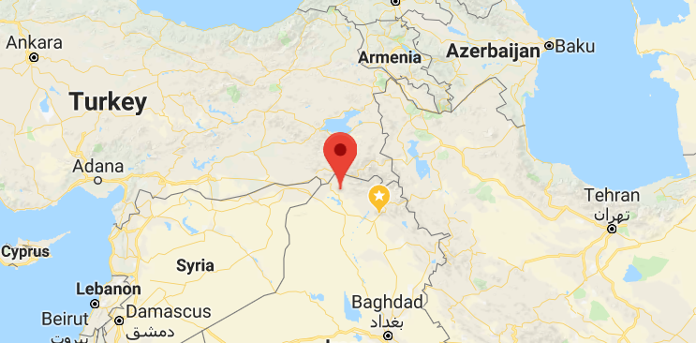
Who are we?
UoD CPCRS: University of Duhok Center for Peace and Conflict Resolution Studies (“UoD Peace Center”)
NYU PREP: New York University Peace Research and Education Program

Slide 3
Moving from M&E to Institutional Learning
History of NYU-UoD partnership
Models of partnerships
Data mobilization
Key Questions
How can information be mobilized into learning for the larger humanitarian and development community?
In what ways can M&E feed into research and connect to relevant academic debate?
How can we think strategically about longer term uses of M&E data?
Concrete examples will be drawn from project implementation experience in the Kurdistan Region of Iraq and Mosul, Iraq.
*Feedback is very welcome*
Benefits and challenges
Lessons learned
Conclusion
Notes:
First, I want to provide some history of the NYU-UoD partnership and map the actors in some of the completed projects to explain input and activity flows and relationship development. Then I’d like to discuss the ways that we have sought to mobilize our data, the avenues we have chosen for mobilizing the data we have generated, the benefits and challenges of walking the line between programmatic and academic peacebuilding work, and our efforts to pivot from program-specific M&E into institutional learning programs.
** Clarify the data (qualitative and small samples)

Slide 4
History of the Partnership

Slide 5
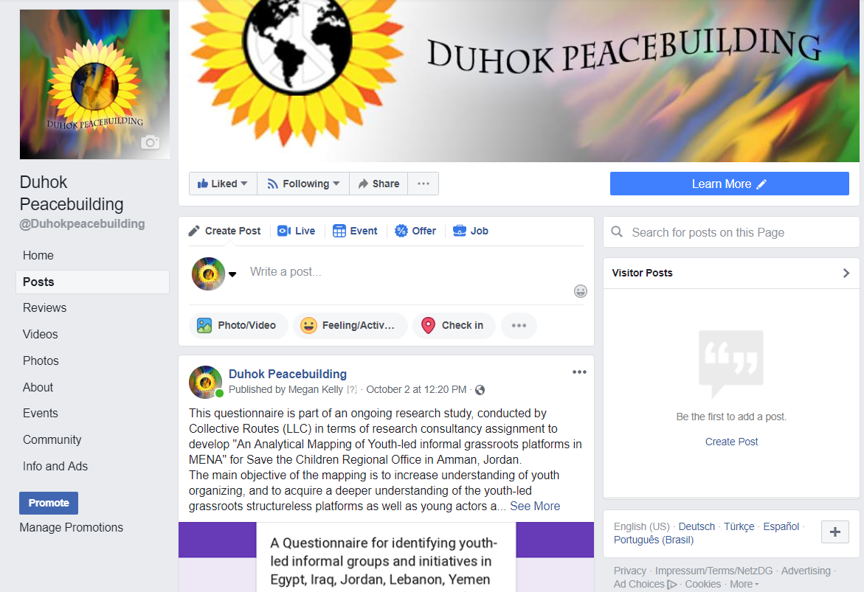
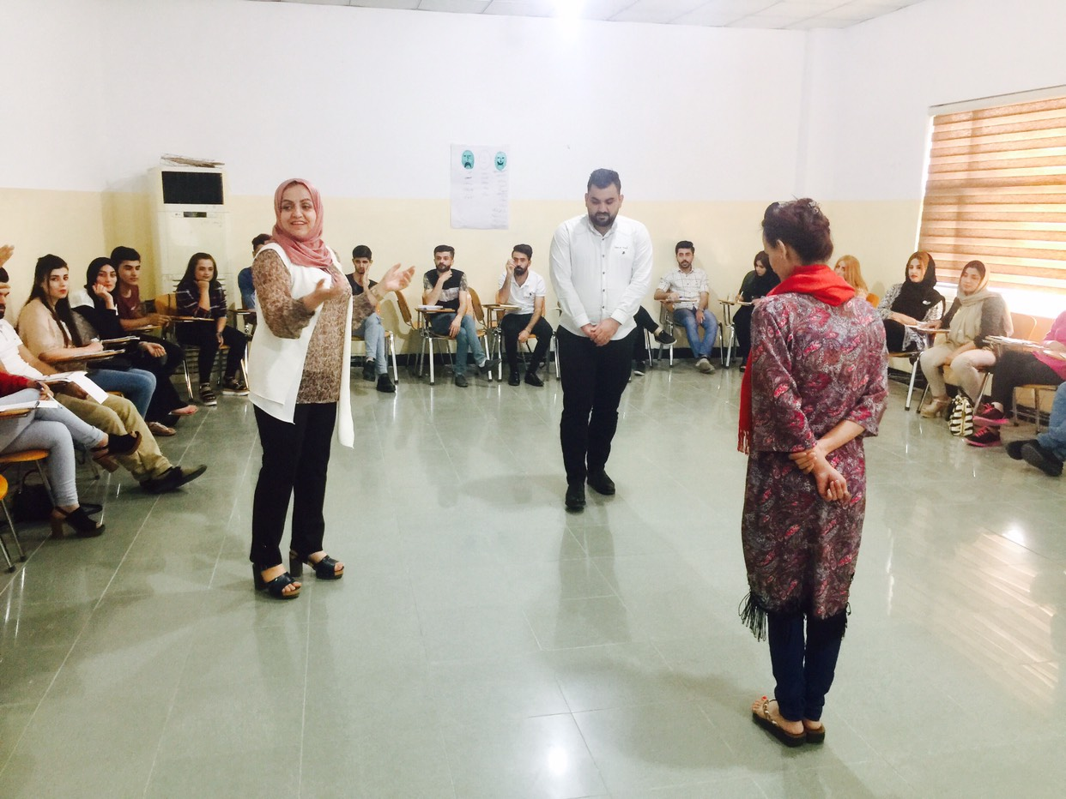
Notes:
What work have we done?
Community Peace Education (US Ambassador’s Fund): youth workshops and events
Improving Social Cohesion (UNDP): Roundtable research, peace clubs in IDP camps, peace skills trainings, establish social media monitoring and messaging, Domiz Refugee camp certificate in peacebuilding
Building Social Cohesion (UNDP): Peace skills training for University of Mosul and University of Duhok faculty; youth conflict transformation training,

Slide 6
Principles of our Methodology
Co-creation
Co-authorship
Co-ownership
Collaboration and compromise

Slide 7
Model 1: Basic partnership
Data outputs: internal reports for NYU and UoD, donor reports, forthcoming working paper for the NYU PREP online journal
Notes:
Donors provide funding and programmatic oversight
NYU provides financial oversight, international staff, and academic consulting
UoD implements the project and provides expertise in local context, local facilitators, facilities, logistical coordination, contextualization of international materials and trainers
As participants and beneficiaries, youth and community members both participate in activities and provide feedback

Slide 8
Notes:
CPE Chamiskho

Slide 9
Notes:
Roundtable- Duhok

Slide 10
Model 2: Developed Partnership
Data outputs: internal reports for donor, this M&E Solutions Forum presentation, possible working paper or journal article

Slide 11
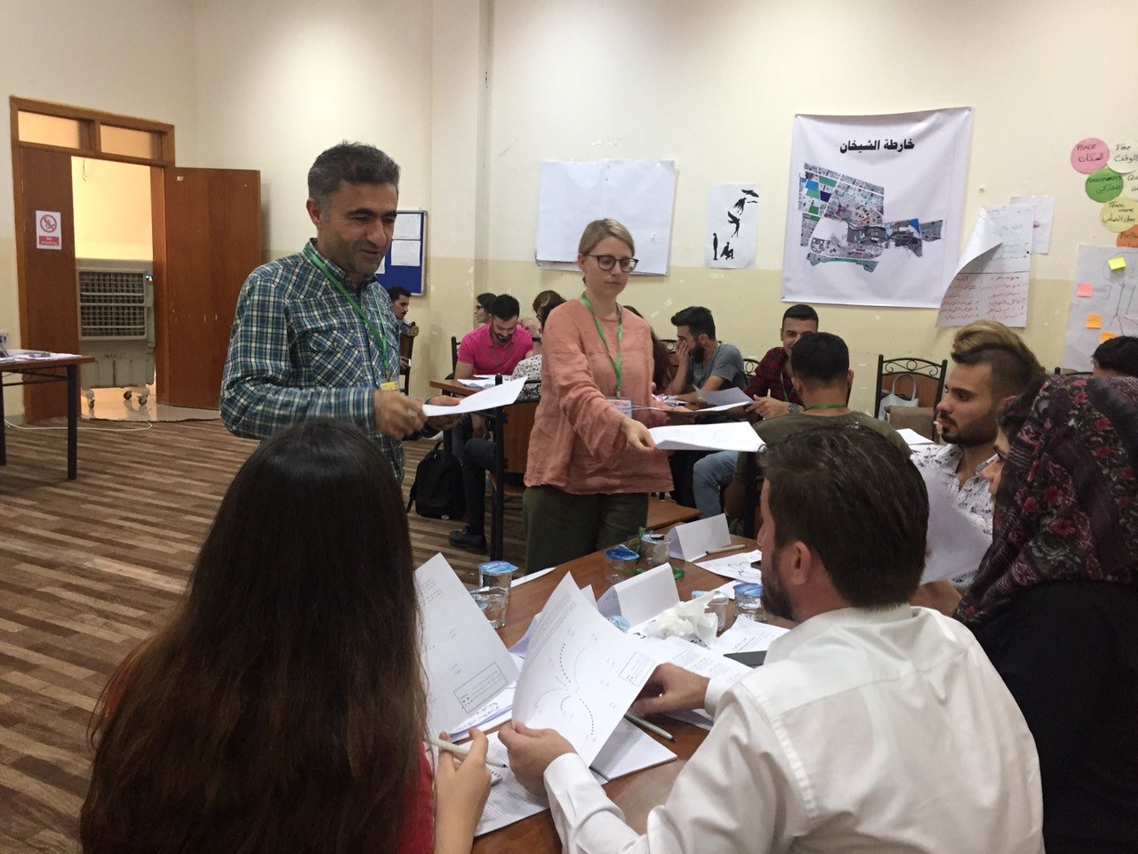

Slide 13
Notes:
UoM and UoD faculty participants

Slide 14
Notes:
UoM Student Workshop

Slide 15
Model 3: Conflict mapping research
Data outputs:
Conference presentation
Co-authored academic paper in the University of Duhok Journal (forthcoming)

Slide 16
Notes:
Erbil Migration Conference

Slide 17
Moving from M&E- Institutional Learning

Slide 18
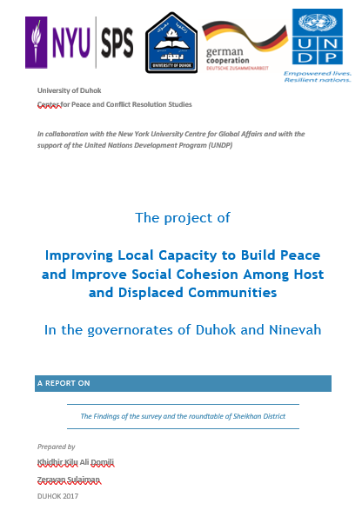
Local Data Mobilization
Notes:
Data success and data failure- either way make the most of it!
Triangulation and conversation
Begin, begin, and begin new again
Feedback solicitation

Slide 19
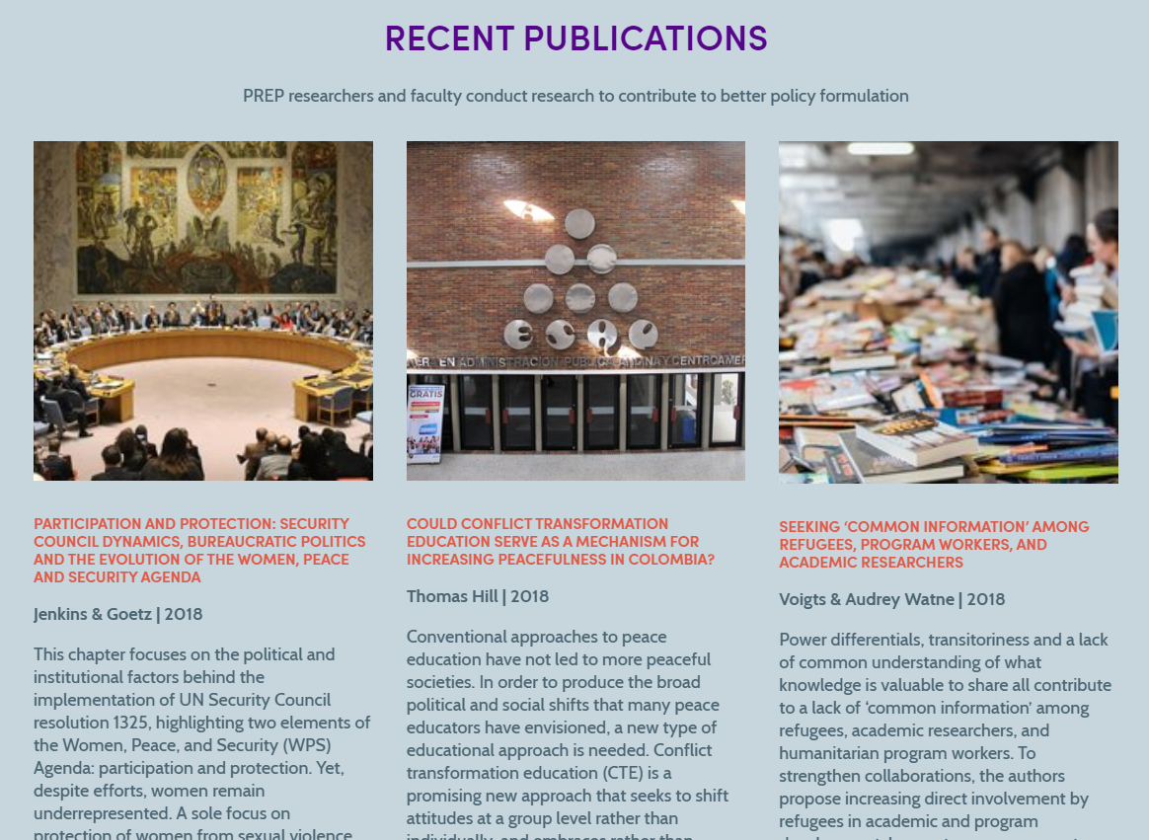
International Data Mobilization

Slide 20
Benefits, challenges, and lessons learned

Slide 21
Thank you
Further questions? Write me: audreywatne@mcc.org

